Slide 1
Overview of the Console Game Market
Based on data from 1985 to 2016
Ken Croker

Slide 2


Made With Tableau and PostgreSQL

Slide 3
Outline
Visualizing the Console Game Market
Sales Overview
Xbox vs PlayStation
Ratings Breakdown
How to Improve Sales
Comparing Publishers
Behind the Scenes: The SQL that Made this Possible
Creating a Database in PostgreSQL
Finding Insights with Queries

Slide 4
Visualizing the Console Game Market
With Tableau Dashboards

Slide 5
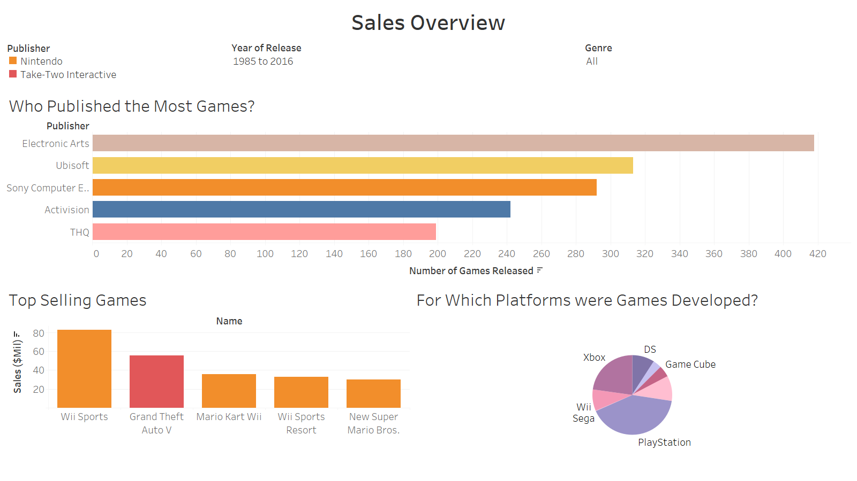

Slide 6
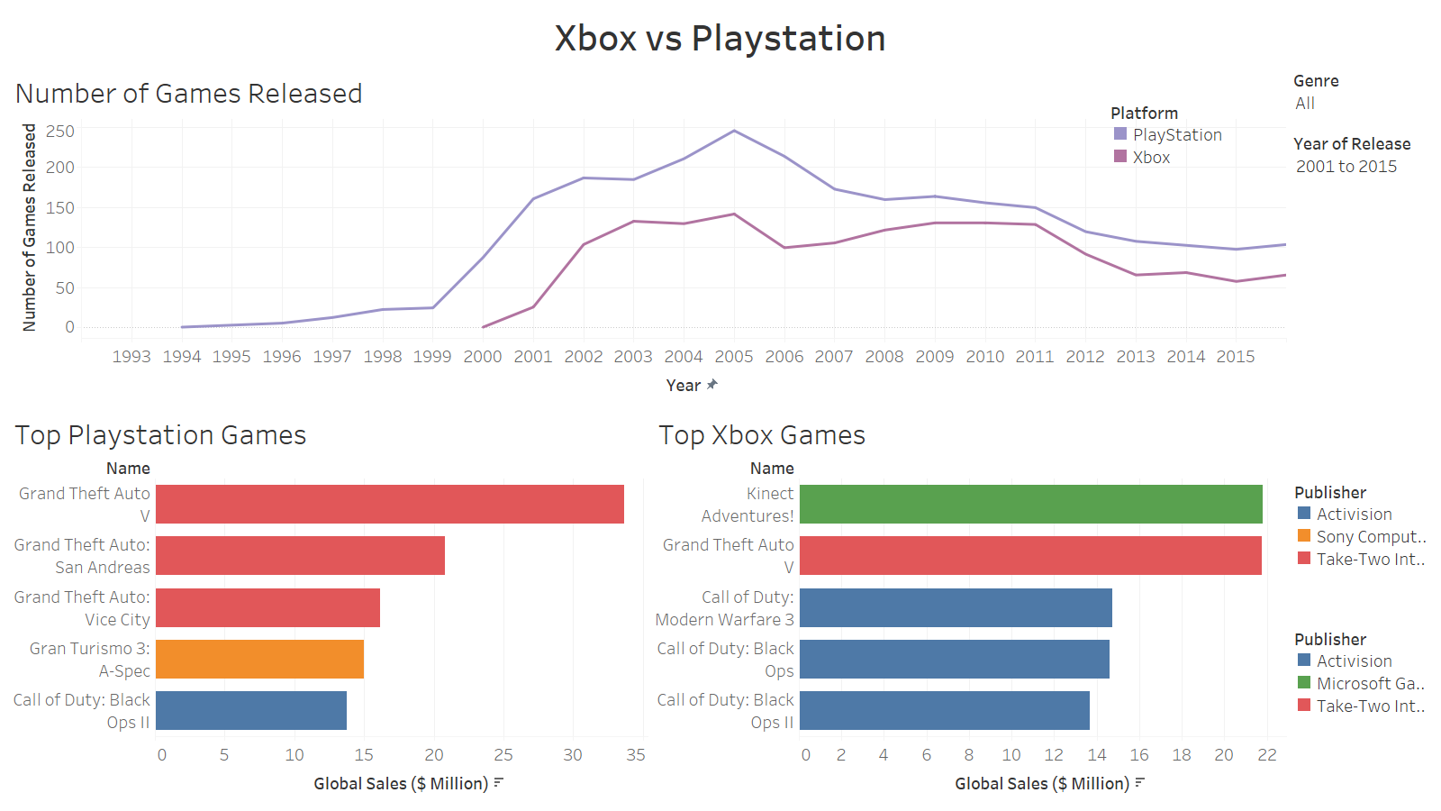

Slide 7
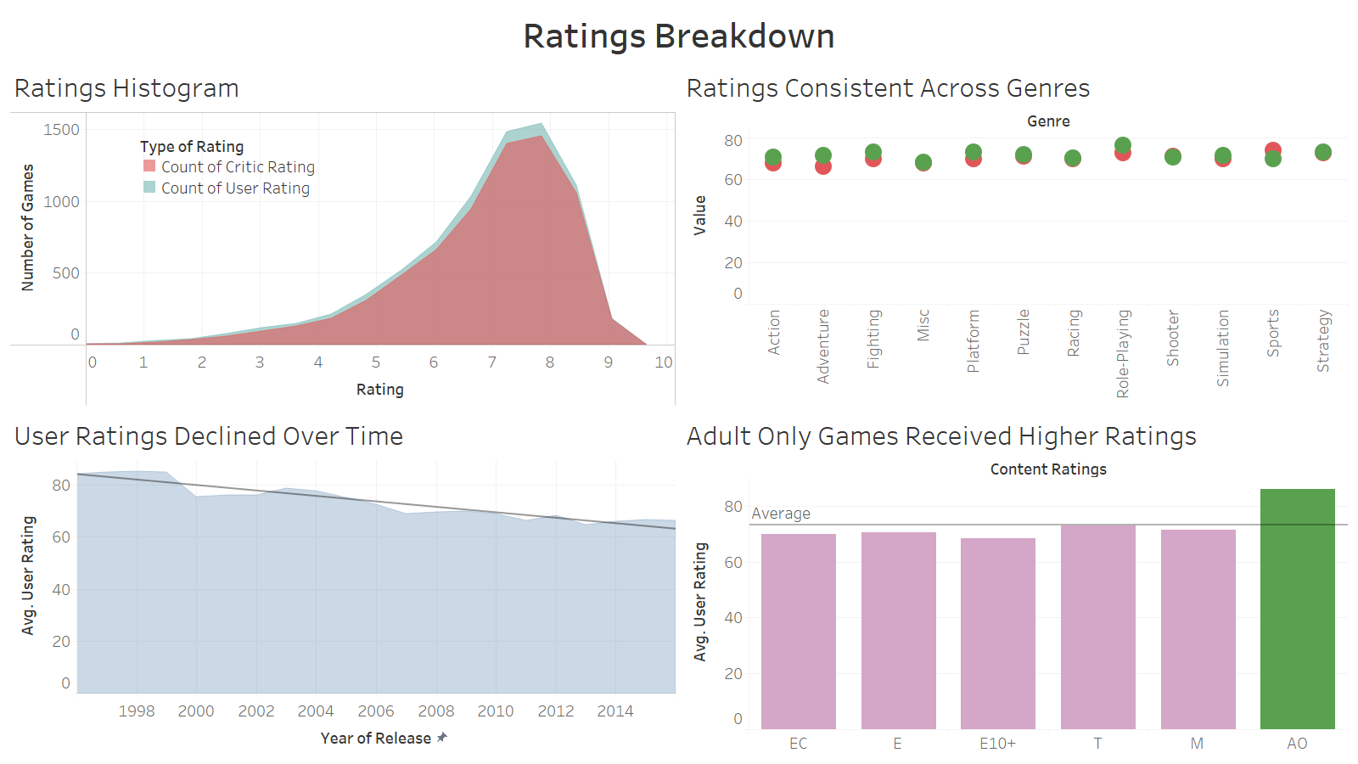

Slide 8
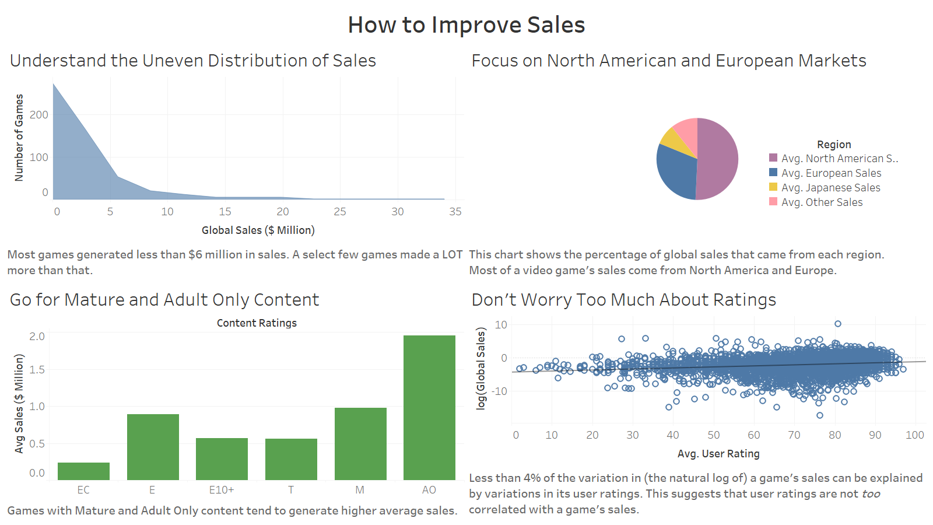

Slide 9
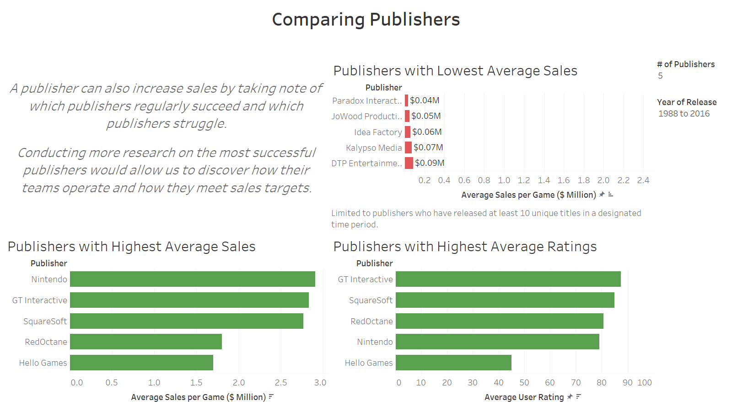

Slide 10
Behind the Scenes
The SQL that made these dashboards possible

Slide 11

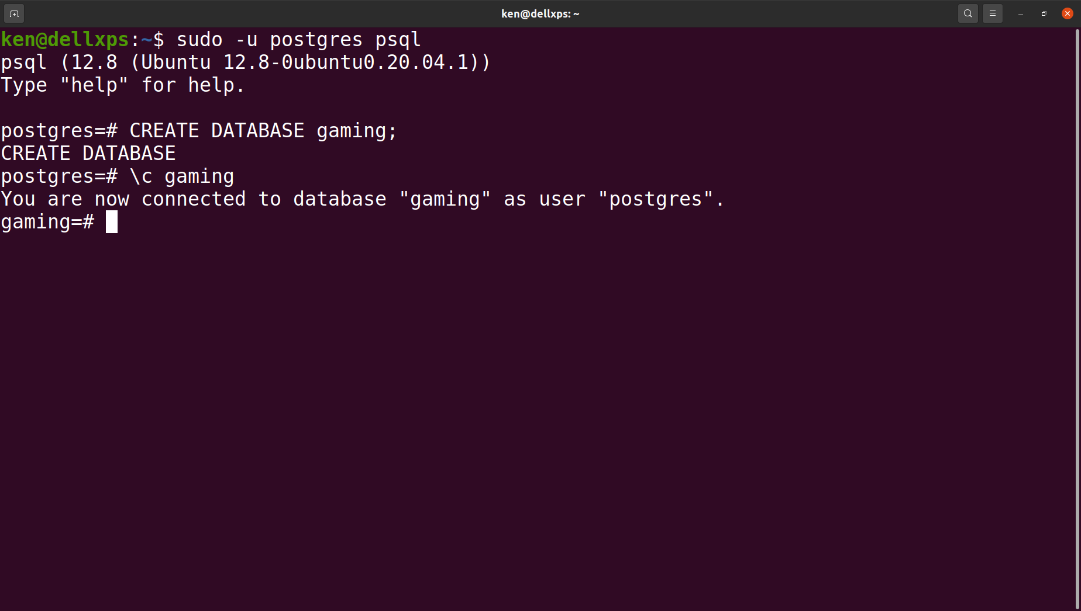

Creating a Database
Before I started creating any charts or visualizations in Tableau, I first created a database using PostgreSQL.

Slide 12
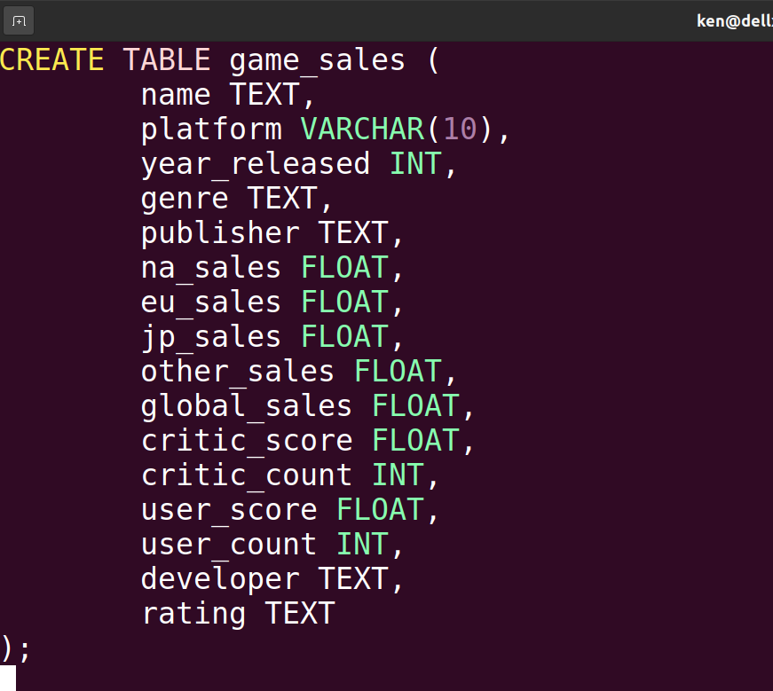
Creating a Table
After setting up the database, I created a table called 'game_sales' for the videogame sales data.
I paid close attention to ensure that each column took the correct data type (text, int, float, etc).

Slide 13
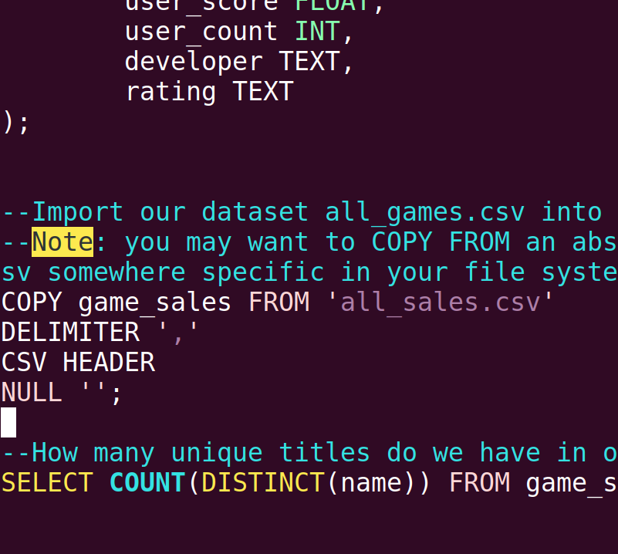
Importing the Data
After setting up the game_sales table, I copied the contents of the csv file into it.
Here's the syntax I used.

Slide 14
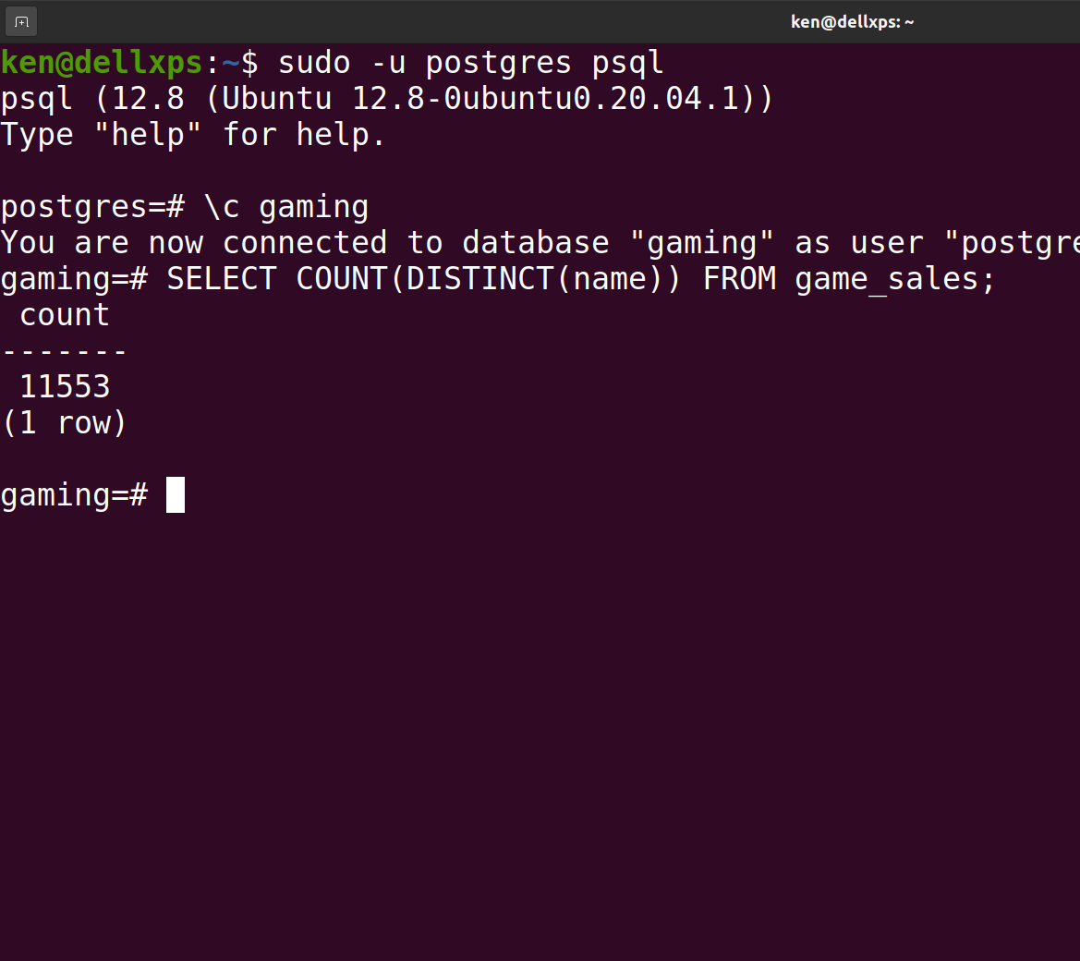
Distinct Game Titles
I first wanted to know how many unique titles were in the dataset, so I ran a query to COUNT how many DISTINCT values were in the name column.
The value returned is 11553, meaning there are 11553 unique console game titles in the data table.

Slide 15
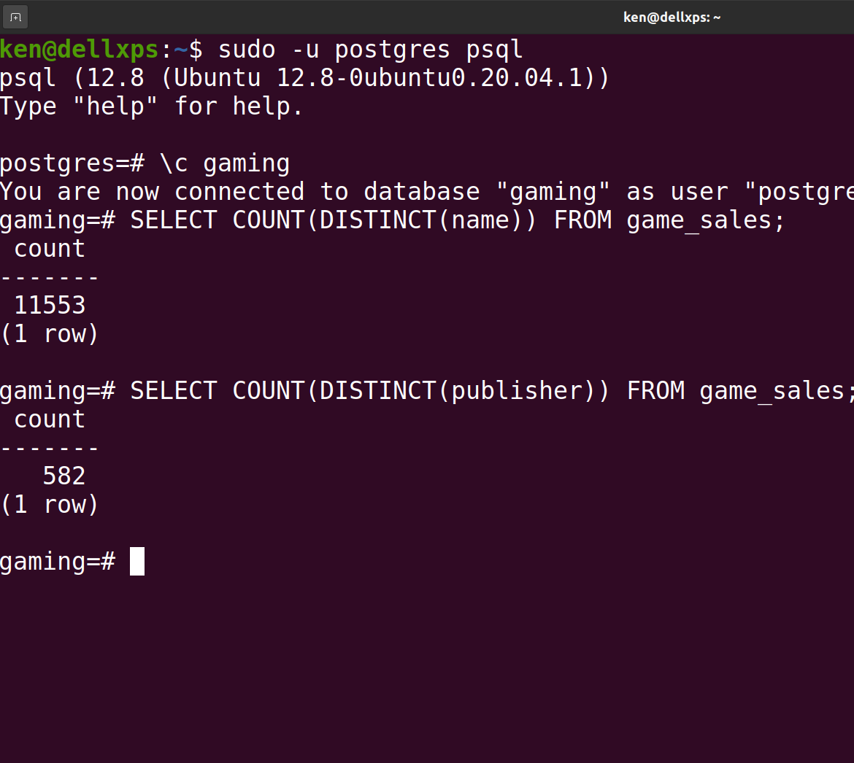
Distinct Publishers
I then ran a similar query for the publishers column.
The value returned is 582, meaning there are 582 unique console game publishers in the data table.

Slide 16
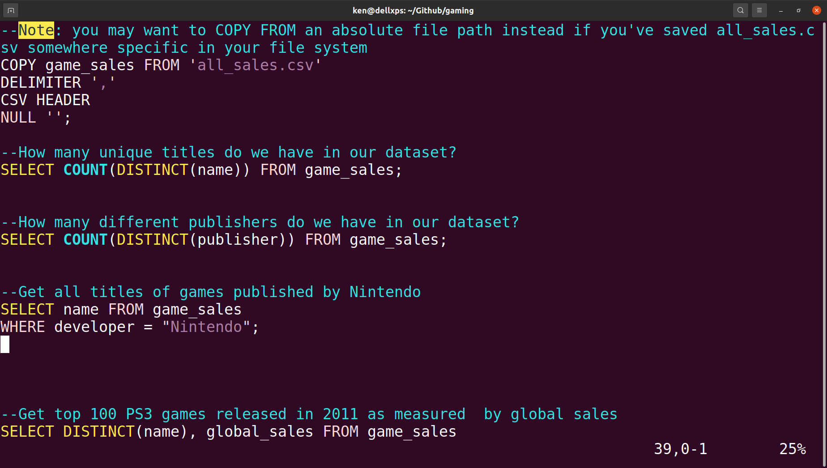
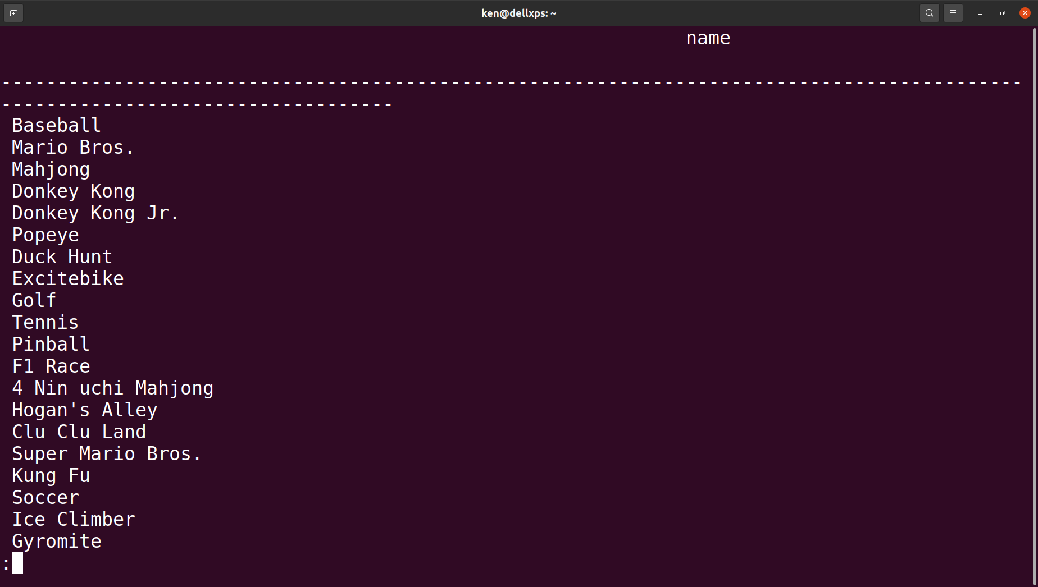
Game Titles From Nintendo
Next, I wanted to see all the game titles Nintendo released, so I ran a SELECT statement to return all values in the name column WHERE Nintendo was the publisher.
The screenshot at the bottom shows the first part of the query’s output.

Slide 17
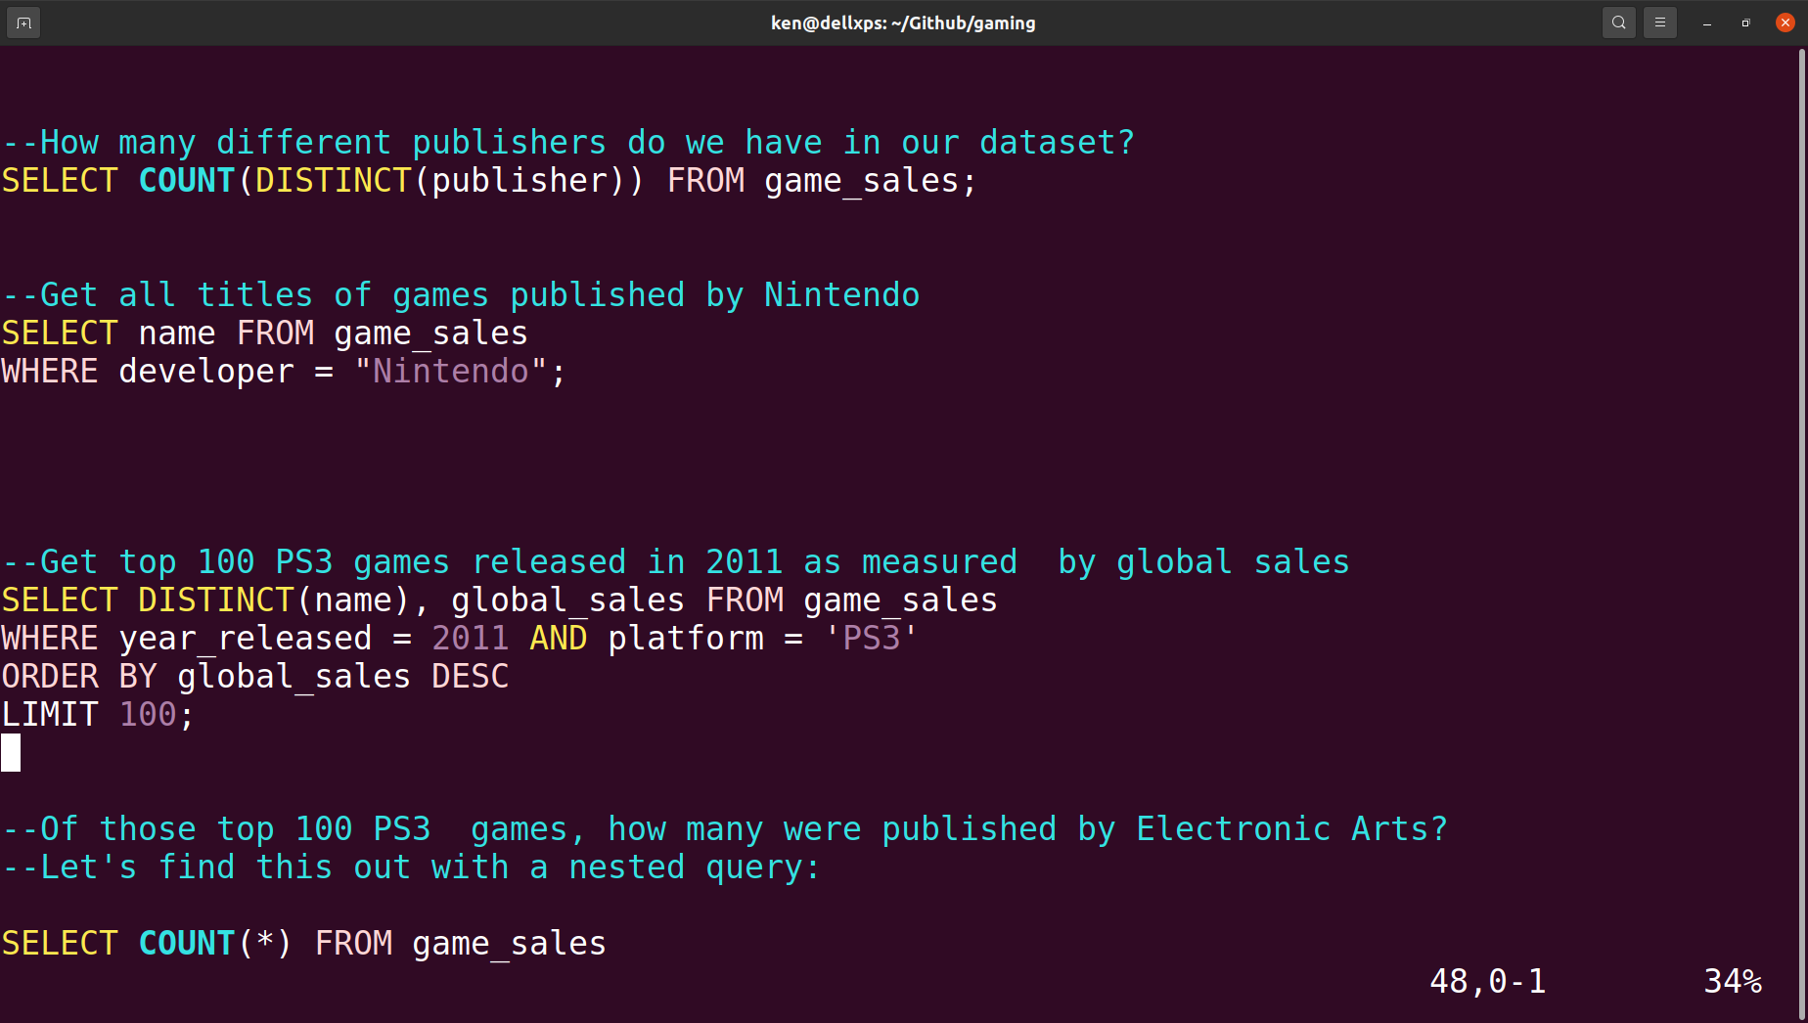
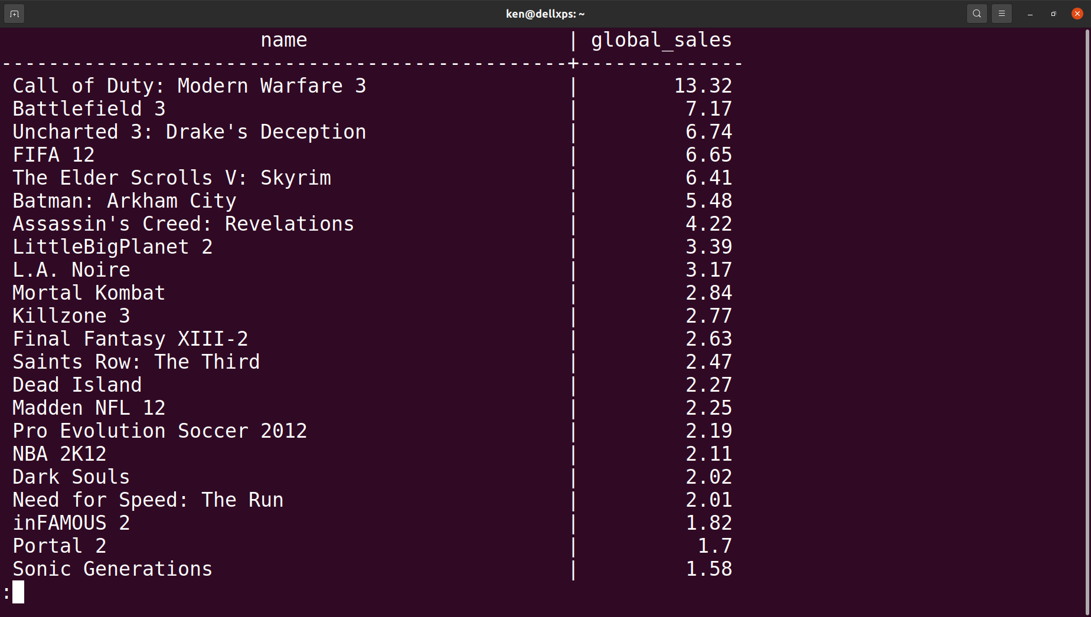
PS3 Games in 2011
I wanted to restrict the table to just the top 100 PS3 games released in 2011, measured by global sales. I only wanted each game’s name and global sales.
The screenshot at the bottom displays the first part of the output.

Slide 18
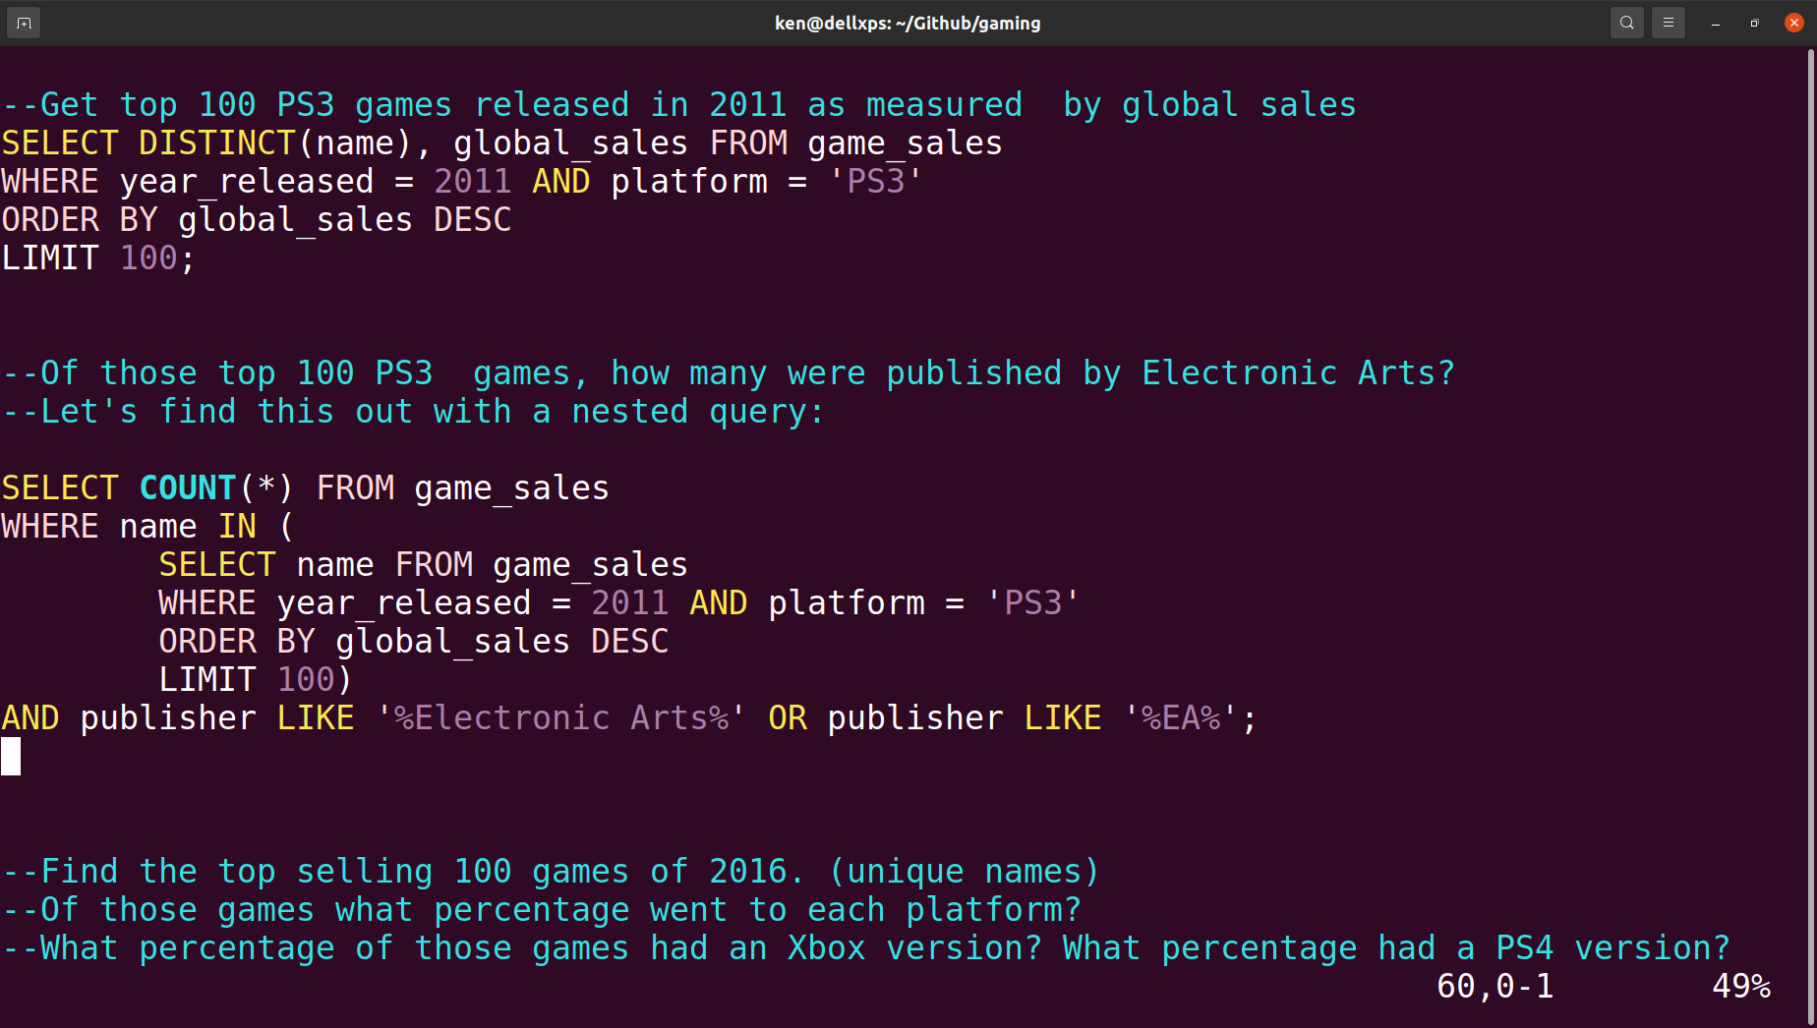
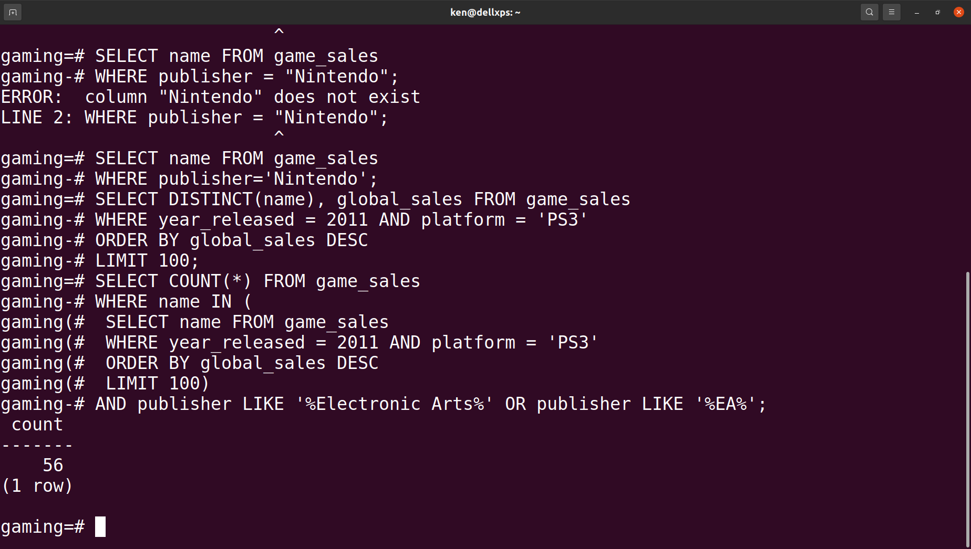
EA’s Dominance in 2011
I wondered how many of these games were published by Electronic Arts, so I ran a nested query to find out. The inner query returns the output shown in the last slide. The outer query selects the entries in the output with a publisher value of ‘Electronic Arts’.
The number 56 is returned, meaning Electronic Arts made 56 of the 100 top selling PS3 games released in 2011.

Slide 19
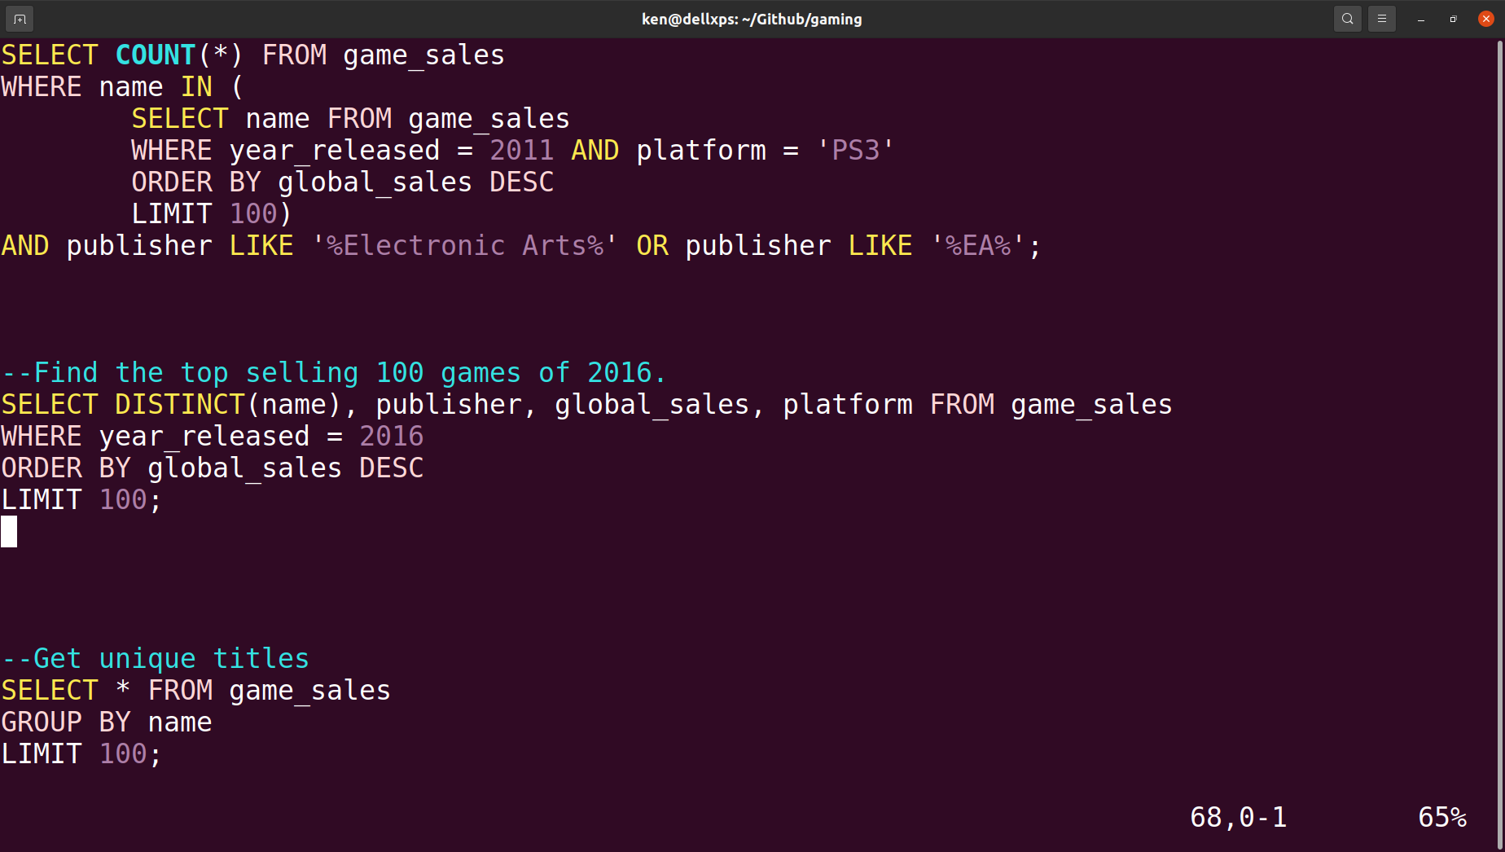
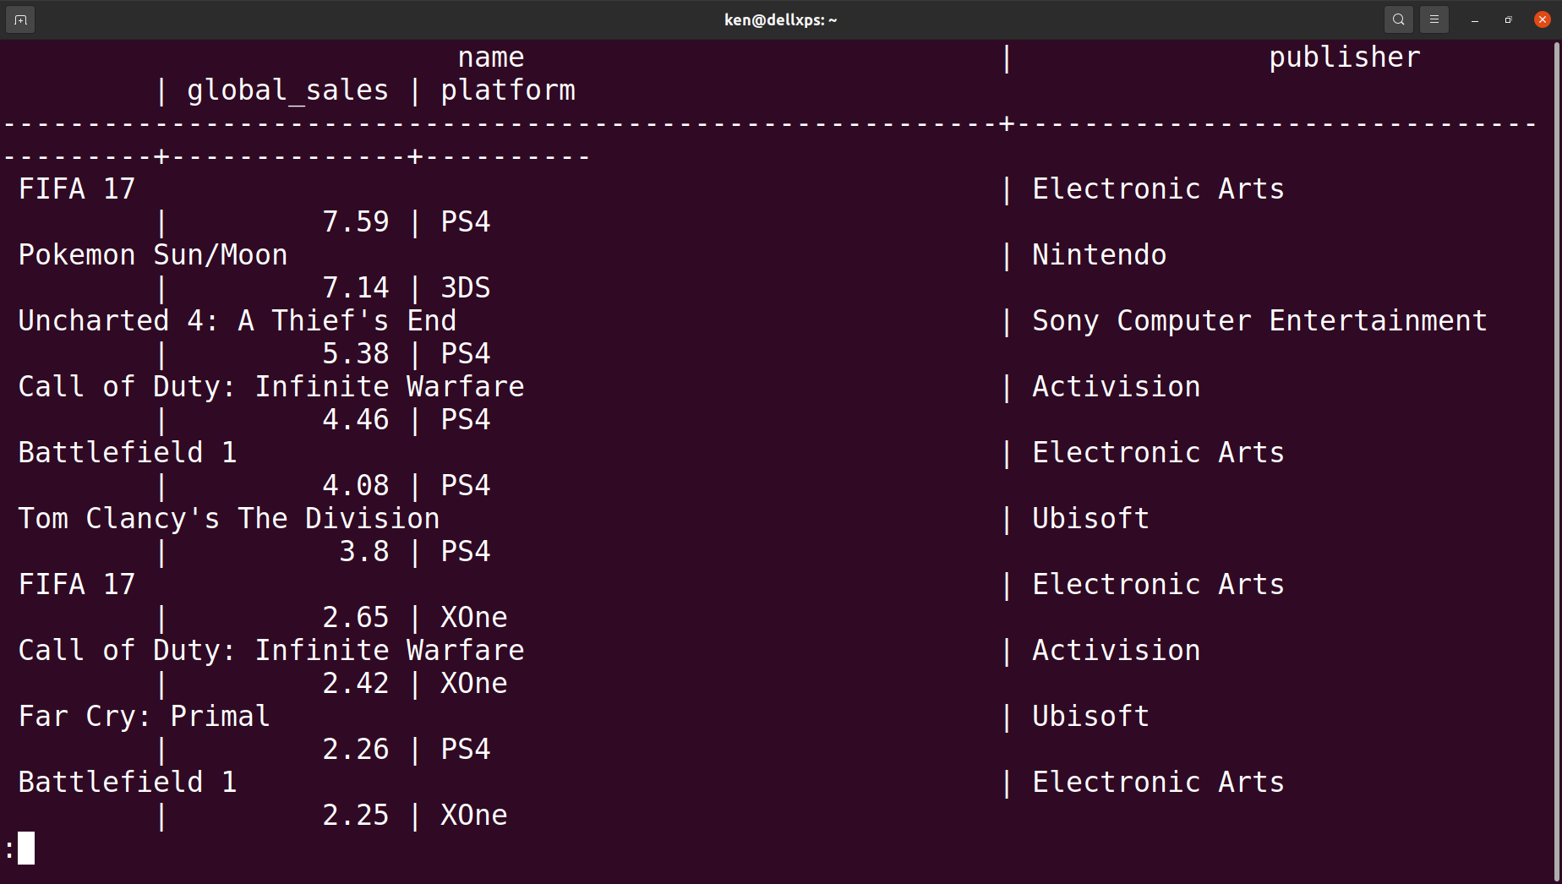
Top Selling Games Released in 2016
Here’s a query that returns the entries of the top 100 selling games released in 2016.

Slide 20
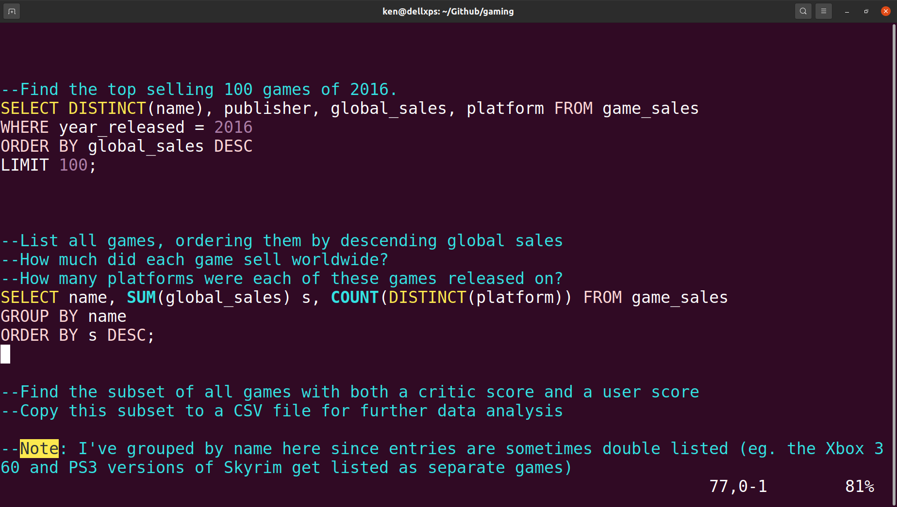
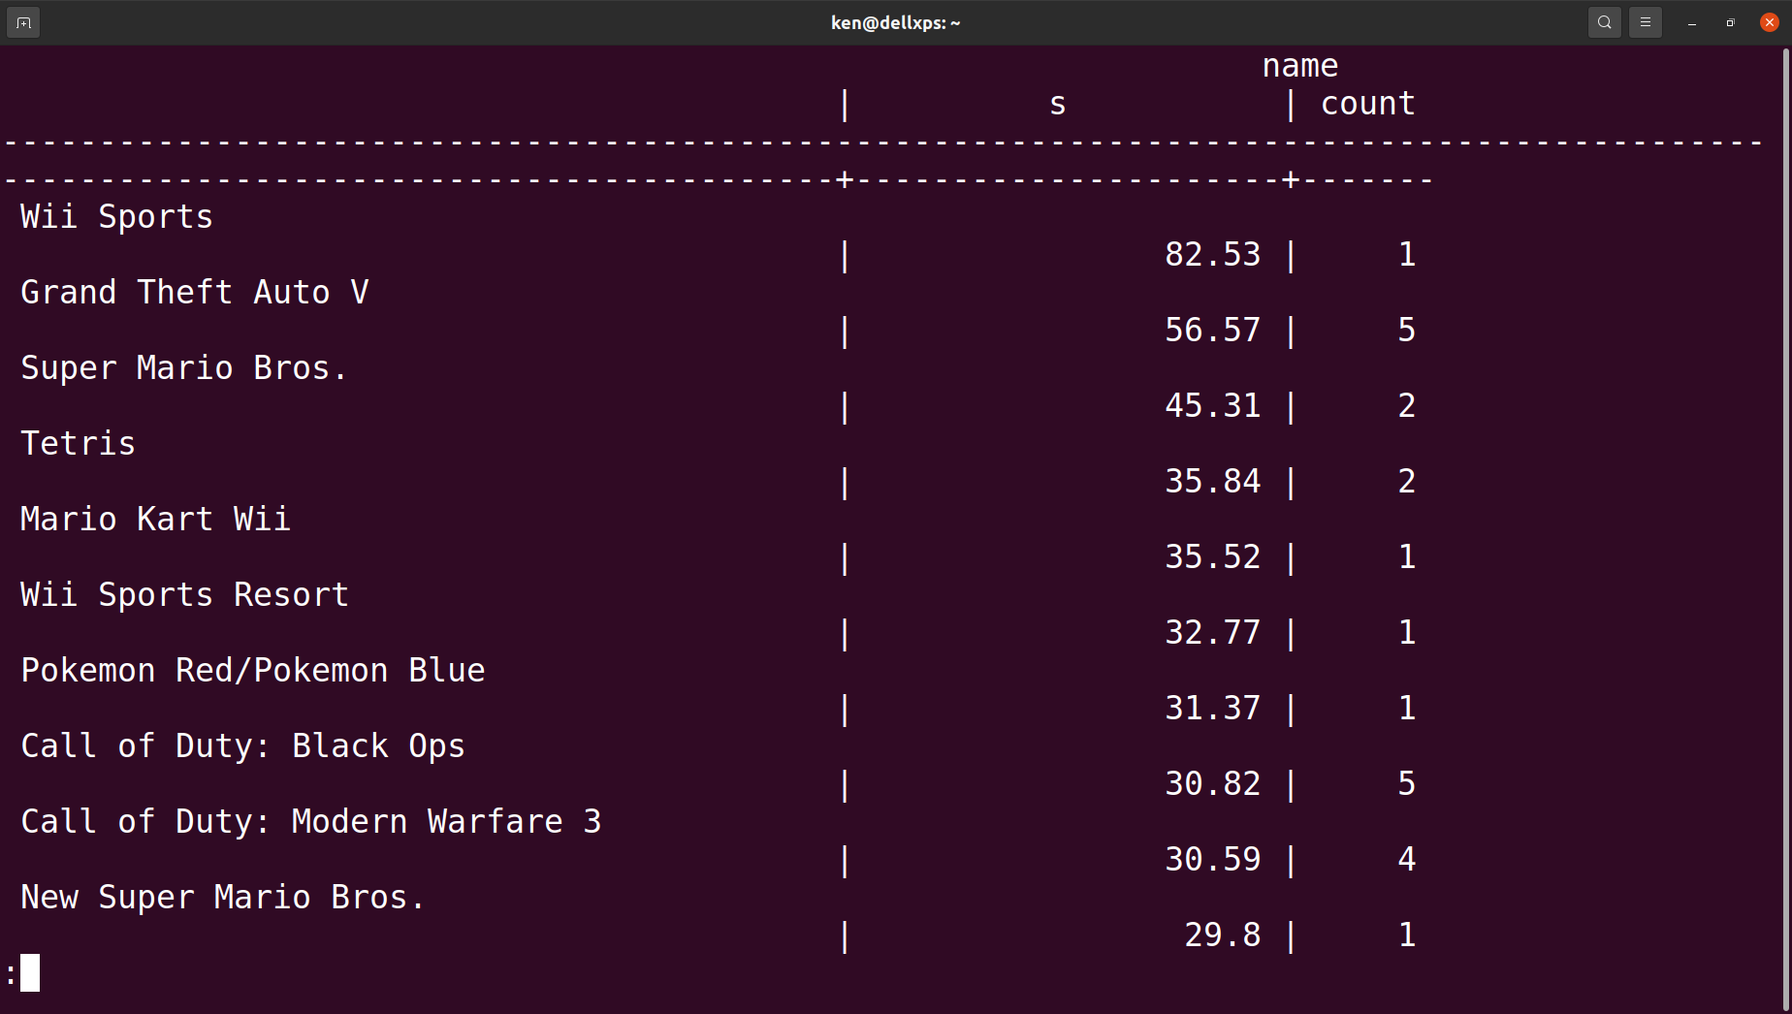
Multiple Platforms Not Required
I wondered how many platforms the top selling games were released on, so I decided to run yet another query.
The values in the platform count column are varied. Some of the top selling games were released on 5 platforms, some were released on just one. Releasing a game on several platforms is NOT a requirement for getting sales.

Slide 21
Thank you for your time!
I learned a lot about the console game market through this project, and I hope you learned something interesting too!

